Slide 1
Quantum Cryptography
Presented by :- Yamoksh Verma
(14/270)

Slide 2
Overview
Introduction
Basic idea in cryptography
Need of quantum cryptography
Properties of Quantum Information
Quantum key distribution
QKD protocols
BB84 without eavesdropping
BB84 with eavesdropping
Working prototypes
conclusions

Slide 3
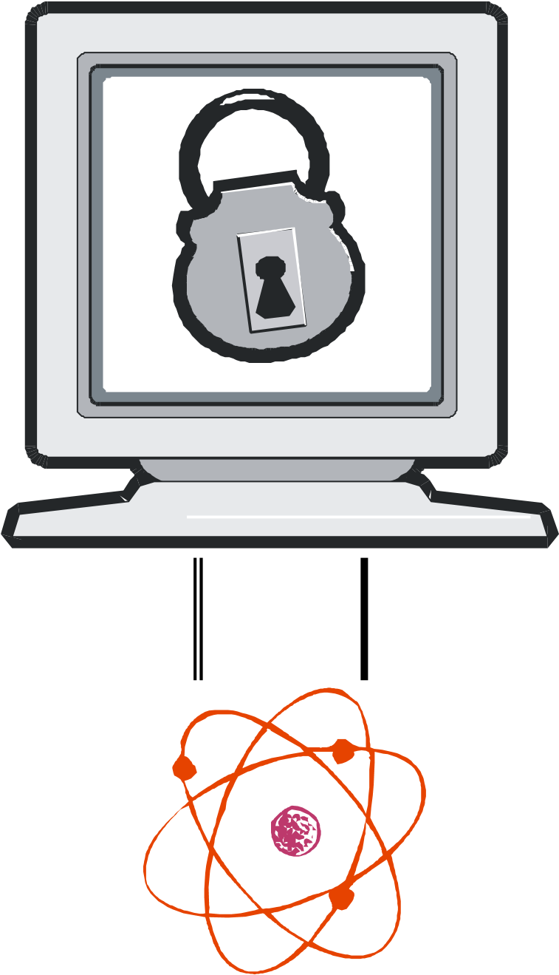
Introduction
Quantum cryptography is the science of exploiting quantum mechanical properties to perform cryptographic tasks.
Light waves are propagated as discrete particles known as photons.
Polarization of the light is carried by the direction of the angular momentum, or spin of the photons.

Slide 4
Basic idea in Cryptography
Cryptography: “the encoding
and decoding of secret
messages.”
The basic idea is to modify
a message so as to make it
unintelligible to anyone but
the intended recipient.
Types of Cryptography
Symmetric Cryptography (Ex. DES, AES, RC5)
Asymmetric Cryptography (Ex. RSA, DSS, PGP)

Slide 5
Why Quantum Cryptography ?
Classical Cryptography relies heavily on the complexity of factoring integers.
Quantum Computers can use Shor’s Algorithm to efficiently break today’s cryptosystems.

Slide 6

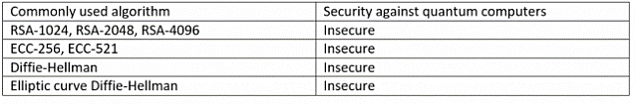
Security Against Quantum Computer

Slide 7
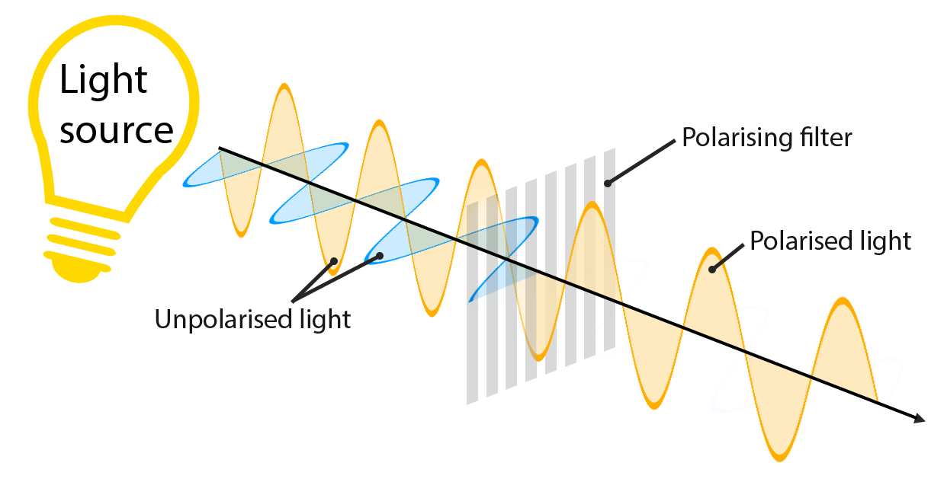
Polarized photons
Polarization can be modeled as a linear combination of basis vectors vertical () and horizontal ().
A quantum state of a photon is described as a vector
quantum cryptography often uses photons in 1 of 4 polarizations (in degrees): 0, 45, 90, 135

Slide 8
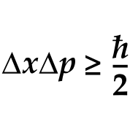

Properties of Quantum Information
Heisenberg Uncertainty Principle (HUP)
If there is a particle, such as an electron, moving through, It is impossibly to measure both its position and momentum precisely.
This simply means that observation of quanta changes its behavior.
No Cloning Theorem
The no-cloning theorem demonstrates that it is impossible to create a copy of an arbitrary unknown quantum state.

Slide 9
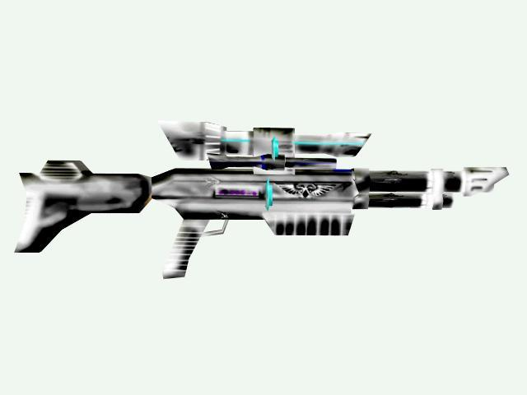
A Polarization Filter
A polarization filter is a material that allows only light of a specified polarization direction to pass.
A photon will either pass or not pass through a polorization filter, but if it emerges it will be aligned with the filter regardless of its initial state. There are no partial photons.








Slide 10
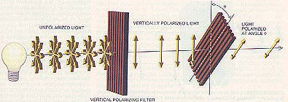
A Polarization Filter
Unpolarized light enters a vertically aligned filter, some light is absorbed and the remainder is polarized in the vertical direction.
A second filter tilted at some angle q absorbs some of the polarized light and transmits the rest, giving it a new polarization.

Vertically polarized light
Unpolarized light


Filter tilted at angle q




Vertical aligned filter

Slide 11
Polarization by a Filter
Transmitting light polarization and measurements determine the polarization of the outgoing light.
Transmitting | Measurement | Outgoing
Alice transmits 1 (+45 degree) | Bob Measures with -45 degree filter | Photos are always blocked
 | Bob Measures with 90 degree filter | 50% photons blocked
 |  | 50% photons pass
Bob transmit 0 (0 degree) | Bob Measures with -45 degree filter | 50% photons blocked
 |  | 50% photons pass
 | Bob Measures with 90 degree filter | Photos are always blocked

Slide 12
Quantum Cryptography(BB84)

Slide 13
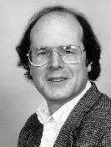
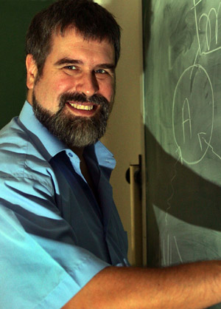
BB84 QKD protocol
Brassard: “Uses polarization of photons to encode the bits of information – relies on “uncertainty” to keep Eve from learning the secret key”.
Bennett: “Quantum cryptography using any two non-orthogonal states”.
Charles H. Bennett
an IBM Fellow at IBM Research
Gilles Brassard
Canada Research Chair in Quantum Information processing

Slide 14
Quantum Cryptography
Better Name – Quantum Key Distribution (QKD) – It’s NOT a new crypto algorithm.
Allows them to verify that the key has not been intercepted.
Observing, or measuring, a quantum system will alter its state.
Example: the Qubit

Slide 15
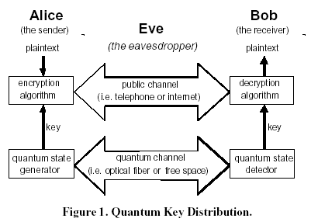
Quantum Key Distribution
Requires two channels
one quantum channel (subject to adversary and/or noises)
one public channel (authentic, unjammable, subject to eavesdropping)

Slide 16
Key distribution
Alice and Bob first agree on two representations for ones and zeroes
One for each basis used, {,} and {, }.
This agreement can be done in public
Define 1 =  0 =  1 =  0 = 
Notes:
The key distrubution protocol presented here was developed by Bennet and Brassard in 1984, hence the name BB84. In its simplest form it is described as follows:

Slide 17
Key distribution - BB84
Alice sends a sequence of photons to Bob. Each photon in a state with polarization corresponding to 1 or 0, but with randomly chosen basis.
Bob measures the state of the photons he receives, with each state measured with respect to randomly chosen basis.
Alice and Bob communicates via an open channel. For each photon, they reveal which basis was used for encoding and decoding respectively. All photons which has been encoded and decoded with the same basis are kept, while all those where the basis don't agree are discarded.
Notes:
Since where their basis agree Bob has measured the bits correctly, they both share the same sequence of 1s and 0s (at this moment I ignore errors due to eavesdropping or noise).
Note that this scheme, on average, will discard 50% of the bits sent.
The remaining bits could be used as key for encryption, although I'll show that there are more work to be done with the key to make it secure in practice.

Slide 18
BB84
representing the types of photon measurements:
+ rectilinear
O/X circular
representing the polarizations themselves:
< left-circular
> right-circular
| vertical
− horizontal
Probability that Bob's detector fails to detect the photon at all = 0.5.

Slide 19
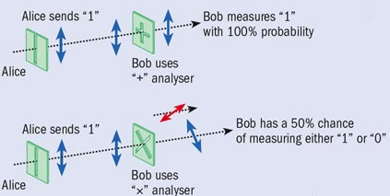
Properties of Quantum Information

Slide 20
BB84 – No Eavesdropping
A → B: |<−−−<<−−<>>−<>||−−<
Bob randomly decides detector:
++++O+O+OO+O+++++O+O
For each measurement, P(failure to detect photon) = 0.5
The results of Bob's measurements are:
− >− −<< |||
B → A: types of detectors used and successfully made (but not the measurements themselves):
+ O+ +OO +++
Alice tells Bob which measurements were of the correct type:
. . . . (key = 0 0 0 1)

Slide 21
BB84 – Eavesdropping
Eve has to randomly select basis for her measurement
Her basis will be wrong in 50% of the time.
Whatever basis Eve chose she will measure 1 or 0
When Eve picks the wrong basis, there is 50% chance that she'll measure the right value of the bit
E.g. Alice sends a photon with state corresponding to 1 in the {,} basis. Eve picks the {, } basis for her measurement which this time happens to give a 1 as result, which is correct.
Notes:
What happens if Eve is hooked up on the quantum channel and measures the photons sent by Alice?
Eve has to randomly select basis for her measurement, since she don't know which of the two Alice used at transmission. Her basis will be wrong in 50% of the time.
Whatever basis she chose she will measure 1 or 0. However, even in those cases when Eve picks the wrong basis, there is 50% chance that she'll measure the right value of the bit. E.g. Alice sends a photon with state corresponding to 1 in the {,} basis. Eve picks the {, } basis for her measurement which this time happens to give a 1 as result, which is correct.

Slide 22
Eavesdropping
Alice’s basis | Alice’s bit | Alice’s photon | Eve’s basis | Correct | Eve’s photon | Eve’s bit | Correct
{,} | 1 |  | {,} | Yes |  | 1 | Yes
 |  |  | {, } | No |  | 1 | Yes
 |  |  |  |  |  | 0 | No
 | 0 |  | {,} | Yes |  | 0 | Yes
 |  |  | {, } | No |  | 1 | No
 |  |  |  |  |  | 0 | Yes
{, } | 1 |  | {,} | No |  | 1 | Yes
 |  |  |  |  |  | 0 | No
 |  |  | {, } | Yes |  | 1 | Yes
 | 0 |  | {,} | No |  | 1 | No
 |  |  |  |  |  | 0 | Yes
 |  |  | {, } | yes |  | 0 | Yes
Notes:
As this table shows, on average, Eve will measure 75% of the bits correct.

Slide 23
Noise
Noise might introduce errors
A detector might detect a photon even though there are no photons
Solution:
send the photons according to a time schedule.
then Bob knows when to expect a photon, and can discard those that doesn't fit into the scheme's time window.
There also has to be some kind of error correction in the over all process.
Notes:
Even though Alice and Bob has used the same basis when measuring the photons in the resulting key, there might be differences in the key due to various reasons. Noise is one of them.
A detector used for measuring the polarized photons might detect a photon even though there are no photons.
One solution to this is to send the photons according to a predefined time schedule.
Then Bob knows when to expect a photon to arrive, and can discard those photons that doesn't fit into the scheme's time window.
There also has to be some kind of error correction in the over all process.

Slide 24
What to come
Theory for quantum cryptography already well developed
Problems:
quantum cryptography machine vulnerable to noise
photons cannot travel long distances without being absorbed
Notes:
The theory for quantum cryptography is well developed and has the potential to bring cryptographers victory in the ongoing battle against cryptoanalysists.
The problem is that that the ability to construct a machine that can take advantage of the quantum cryptography is difficult. Any influence on a photon will change its polarization, which makes it vulnerable to noise.
Another major problem with quantum cryptography is that photons cannot travel long distances without being absorbed. The longest distance researchers has managed to transmit a single photon is about 100 km. However, research on transmitting many photons together, to extend the distance and enhance speed, is going on.
There are also two companies with plans to release commercial products for quantum cryptograpy during 2004

Slide 25
Eves problem
Eve has to re-send all the photons to Bob.
Will introduce an error, since Eve don't know the correct basis used by Alice.
Bob will detect an increased error rate.
Still possible for Eve to eavesdrop just a few photons, and hope that this will not increase the error to an alarming rate. If so, Eve would have at least partial knowledge of the key.
Notes:
Eve then has to re-send all the photons to Bob.
By doing so she will introduce an error, since Eve don't know the correct basis used by Alice, and has to pick her basis randomly.
This error will show up as an increased error which can easily be detected by Bob.
Needless to say, the possibility to detect eavesdropping, is one of the major advantages with quantum cryptography over conventional cryptography.
It is still possible for Eve to eavesdrop just a few photons, and hope that this will not increase the error to an alarming rate. If so, Eve would have at least partial knowledge of the key.
Counter-actions against this kind of attack is described below.

Slide 26
Detecting eavesdropping
When Alice and Bob need to test for eavesdropping
By randomly selecting a number of bits from the key and compute its error rate
Error rate < E_{max} ⇒ assume no eavesdropping
Error rate > E_{max} ⇒ assume eavesdropping (or the channel is unexpectedly noisy) Alice and Bob should then discard the whole key and start over
Notes:
When Alice and Bob has agreed on the key to use they need to test for eavesdropping.
This is done by randomly selecting a specific number (n) of bits from the key and compute its error rate. I.e. Alice and Bob compare the n bits over an, possible, open channel and then discard these bits. If the error rate is below a tolerable error rate E_{max}, they can assume no eavesdropping has been done.
On the other hand, if the error rate is larger than E_{max}, someone has monitored their communication or the channel is unexpectedly noisy.
Alice and Bob should then discard the whole key and start over.

Slide 27
Pros & Cons
Nearly Impossible to steal
Detect if someone is listening
“Secure”
Distance Limitations
Availability
vulnerable to DOS
keys can’t keep up with plaintext

Slide 28
Summary
The ability to detect eavesdropping ensures secure exchange of the key
The use of one-time-pads ensures security
Equipment can only be used over short distances
Equipment is complex and expensive

Slide 29
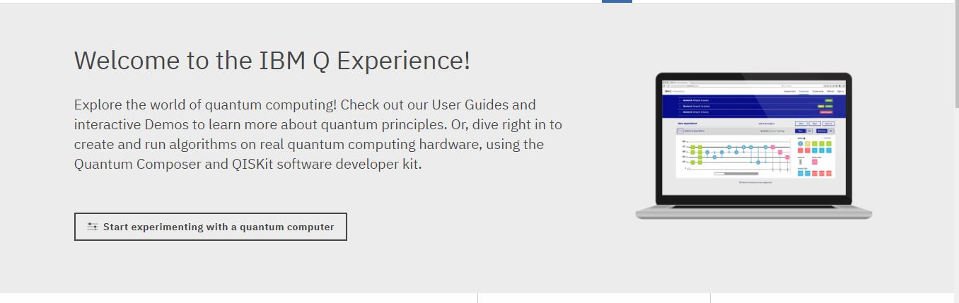
IBM Q Experience

Slide 30
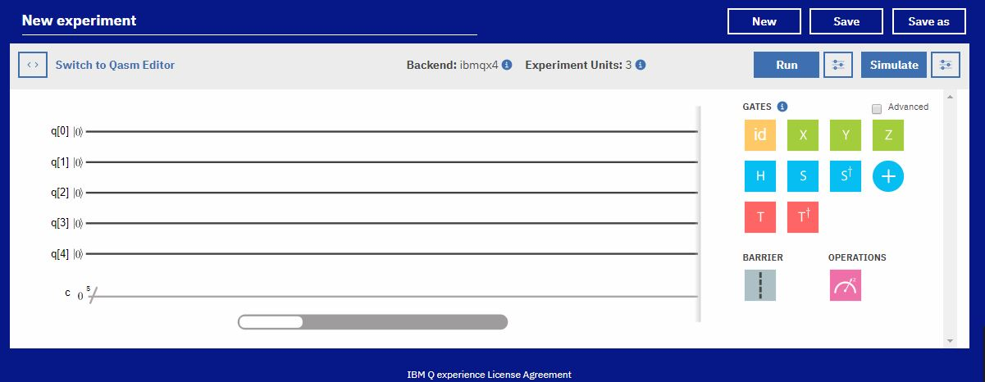
IBM Q Experience

Slide 31
Any code made by humans, can be broken by humans.
- Thanks

